Slide 1
CS184 Final Project Milestone Slides
Jeff Yu
Bing Bo

Slide 2
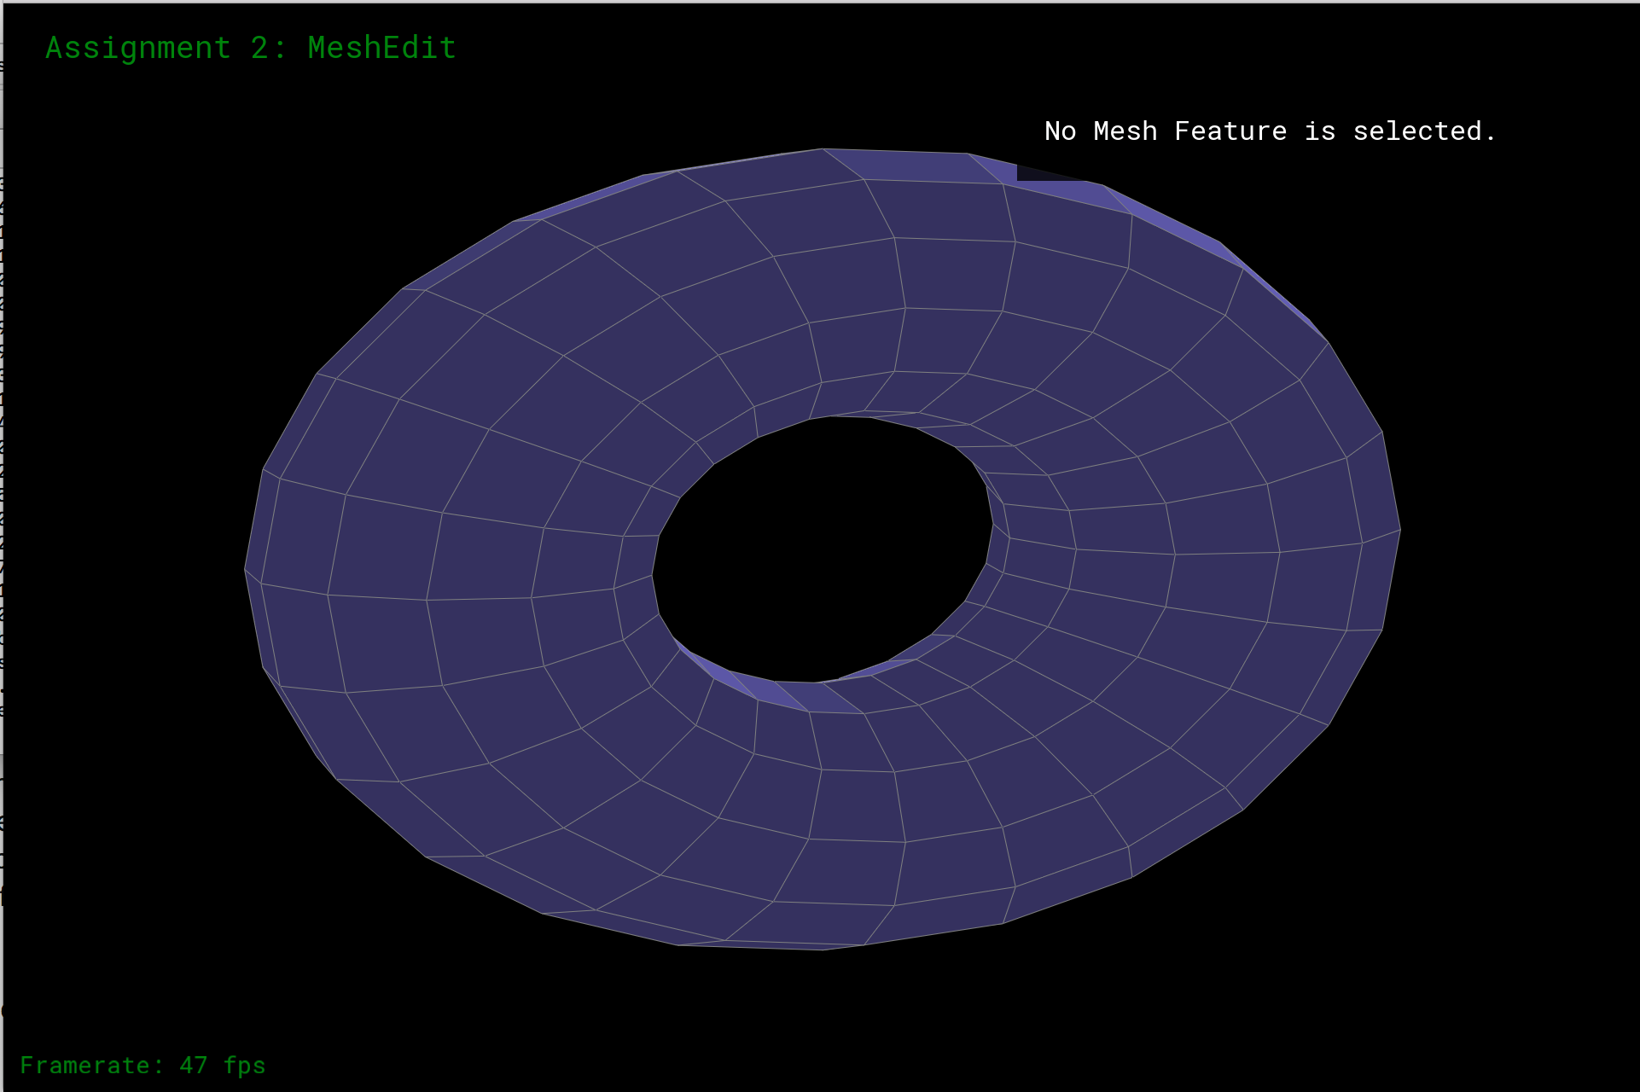
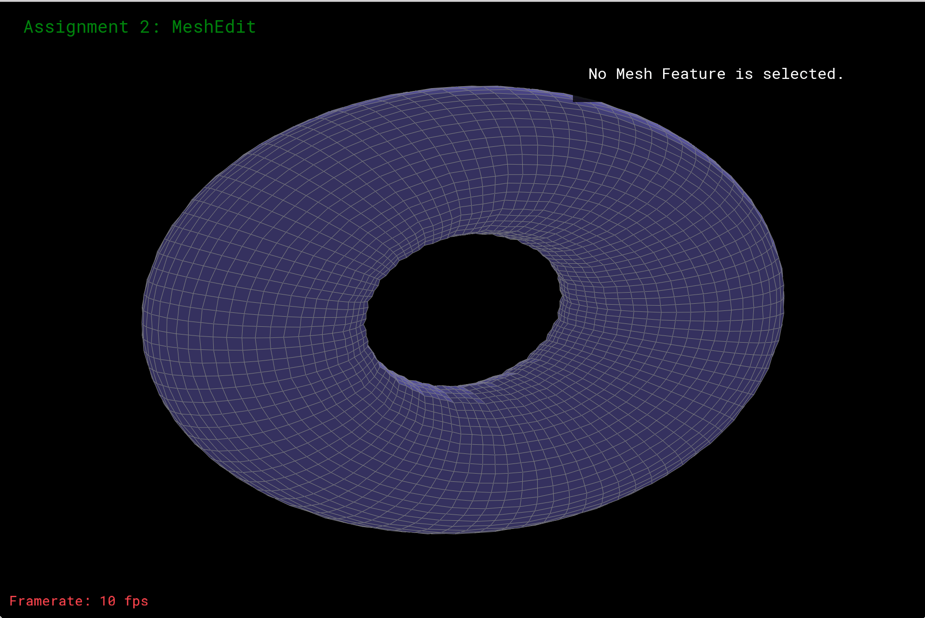
Catmull-Clark Subdivision
quad-based torus
Original torus
Torus after two subdivisions

Slide 3
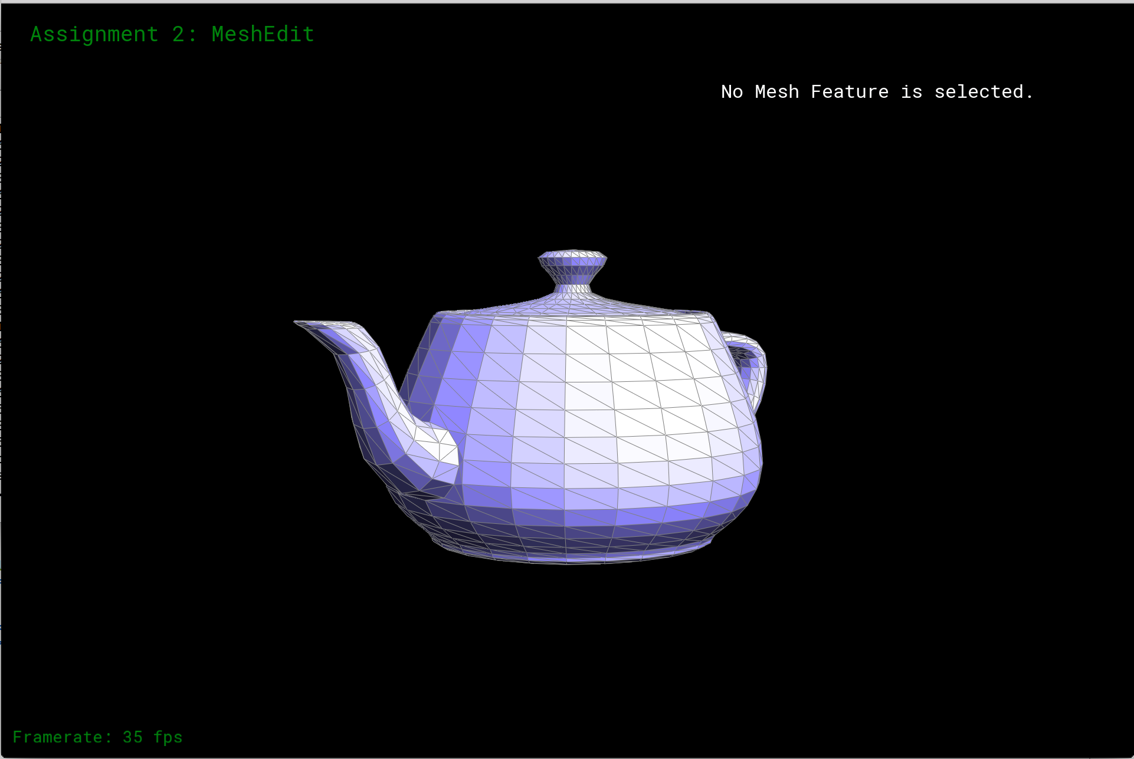
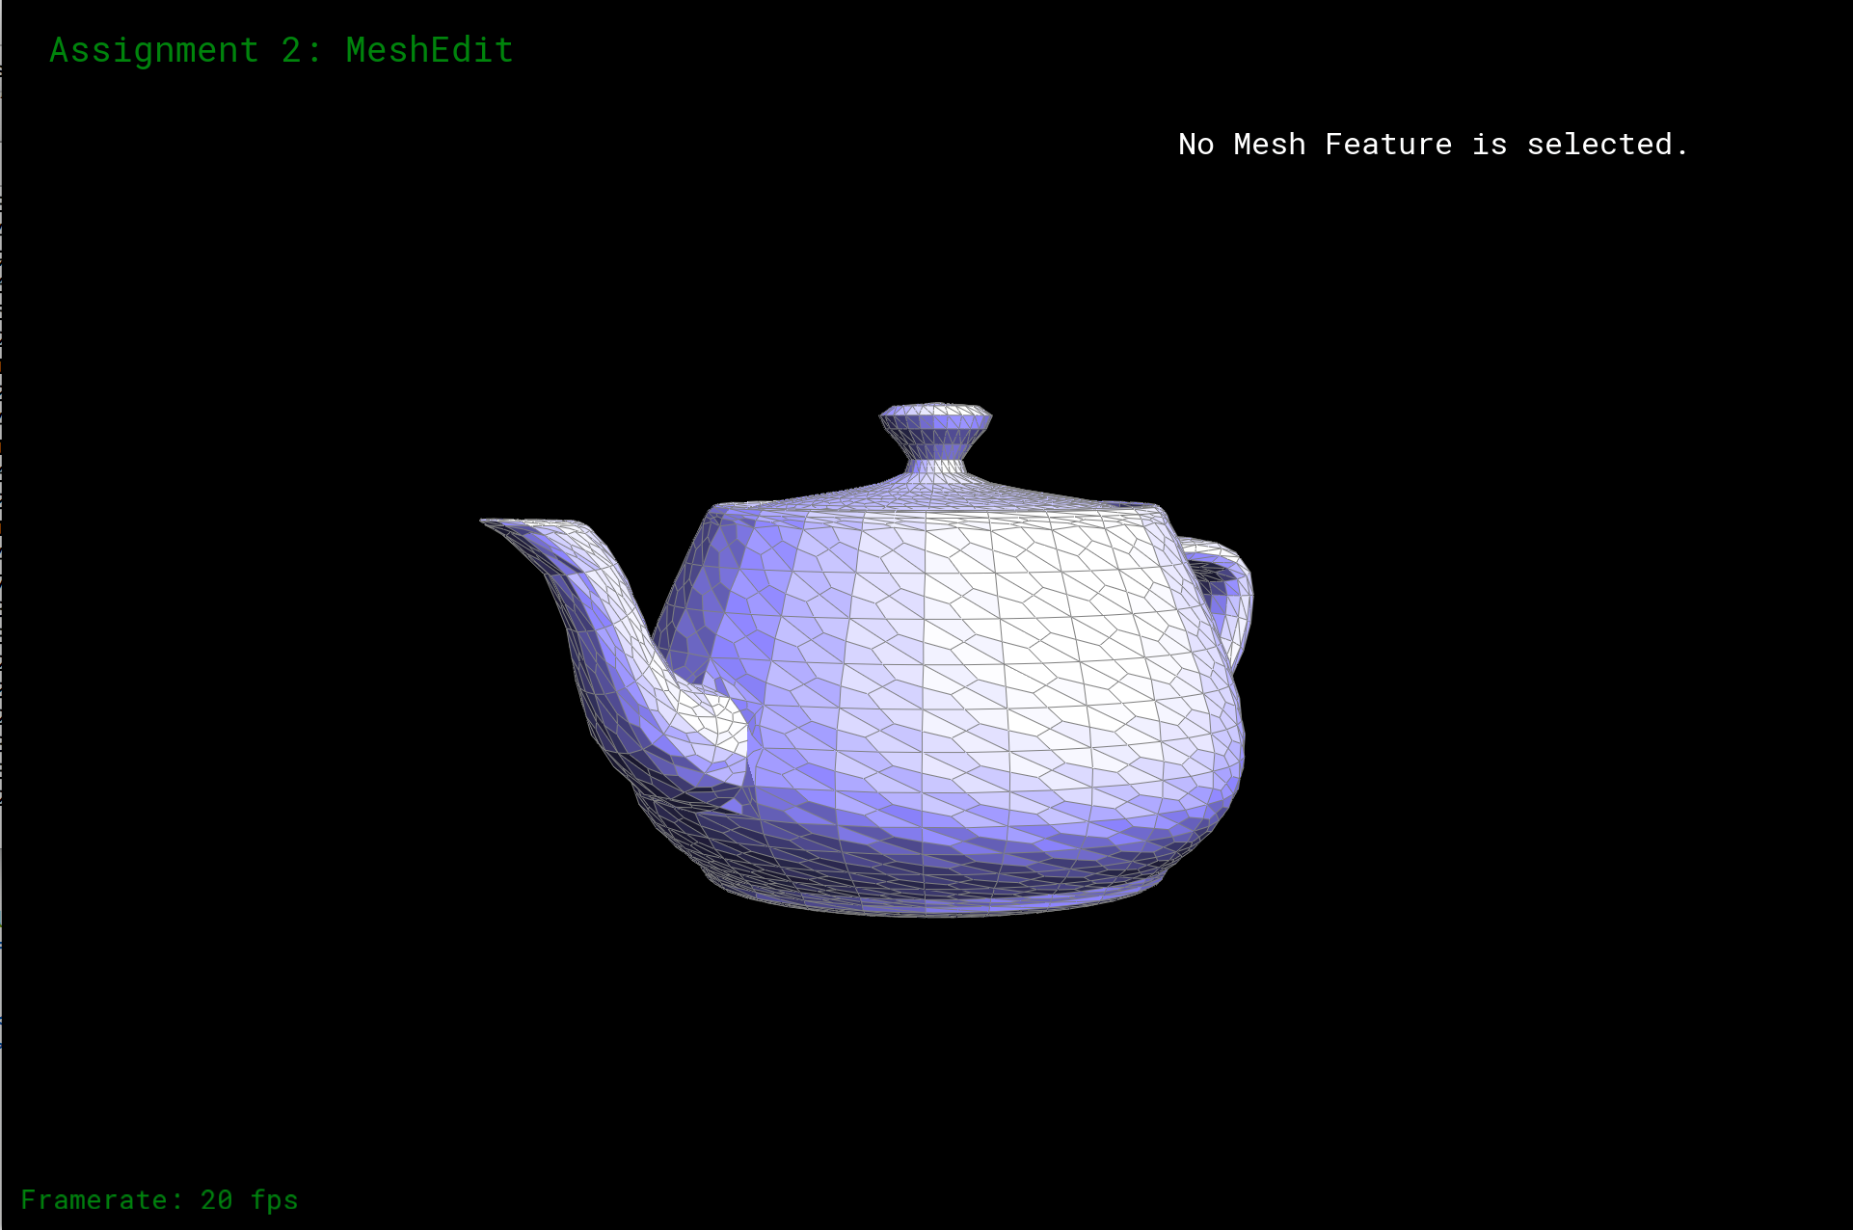
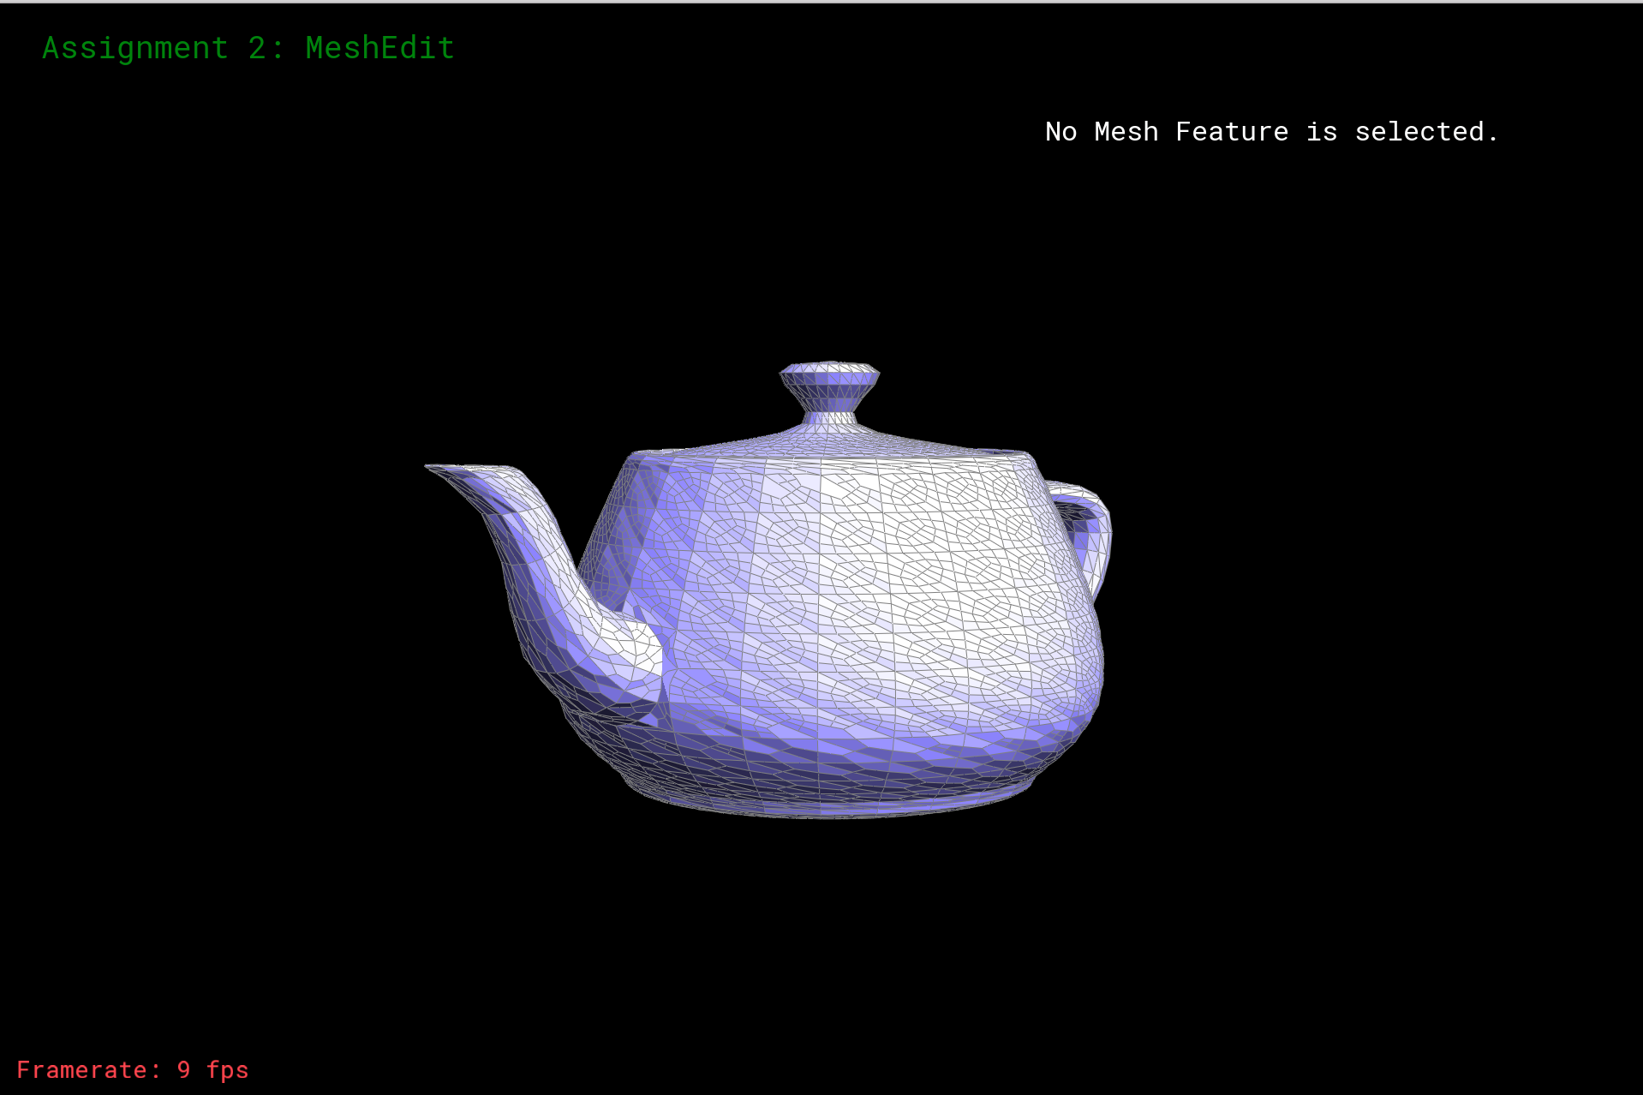
Catmull-Clark Subdivision
Triangle-based meshes

Slide 4
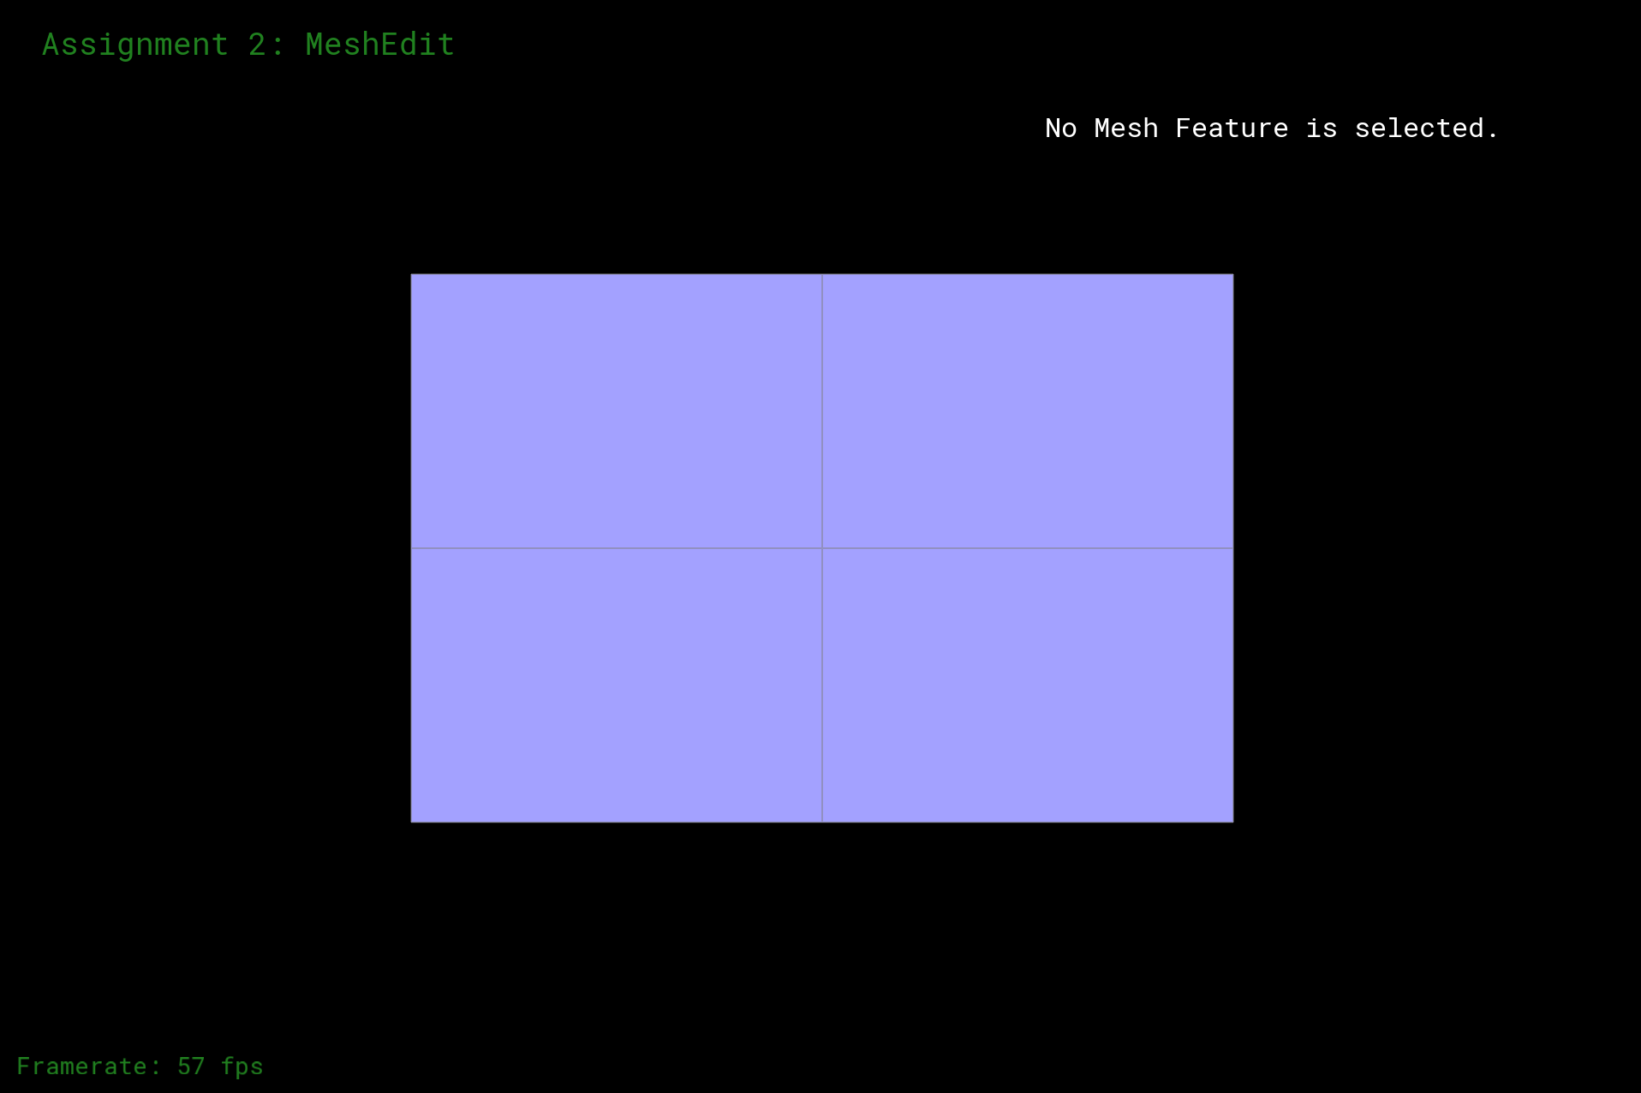

Adaptive Subdivision
without
with

Slide 5
Thank you!

